Slide 1
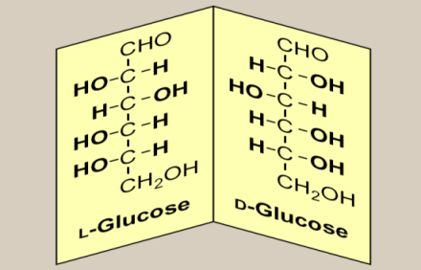
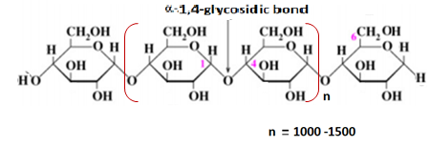
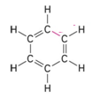
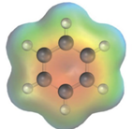
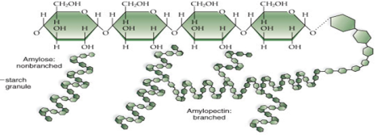

CHM 102 GENERAL CHEMISTRY II (2 UNITS)
MODULE 5
CHEMISTRY OF SOME IMPOTANT ORGANIC COMPOUNDS

Slide 2
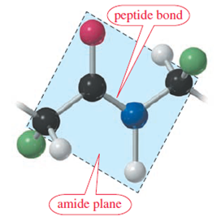
OBJECTIVES
To distinguish between various types of organic molecules.
To discuss the physical and chemical properties of aliphatic hydrocarbons.
To explain the classifications of carbon and hydrogen atoms respectively.
To distinguish between condensed-, expanded-, and line angle- structure.
To discuss the bonding characteristics of carbon atom in organic molecules.
To recognize various derivatives of carboxylic acids.

Slide 3
Keywords
Crude oil → Crude oil refers to a mixture of hydrocarbons that exists in liquid phase in the natural underground reservoirs.
Inorganic compounds → Are those compounds other than hydrocarbons and their derivatives.
Covalent bond → Covalent bond is a strong bond that involves the sharing of electrons to form electron pairs between the two bonding atoms.
Successive members → Successive member has one carbon atoms (or -CH₂- unit) than the preceding one (member).
Cracking → A process by which means heavy hydrocarbons are broken down into lighter molecules using heat, pressure and catalyst.
Tetrahedral structure → A kind of structure displaying a carbon atom with four attachments, and bond angles of approximately 109.5º.

Slide 4
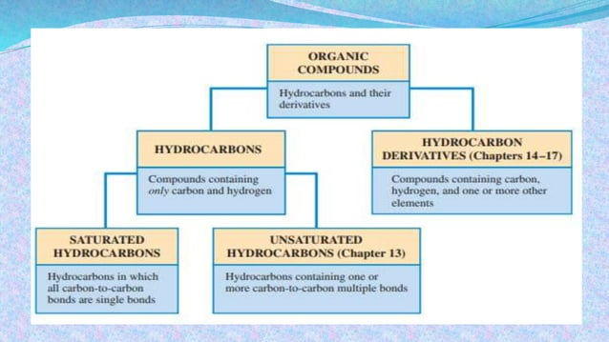
INTRODUCTION
Organic chemistry is the study of hydrocarbons (compounds of carbon and hydrogen) and their derivatives. Hence organic compounds could be defined as compounds of carbon and their derivatives.
However, some exceptions occur with certain compounds of carbon such as CO, CO₂, Na₂CO₃ etc., which are still presented as inorganic compounds. Even though, both of them contain carbon.
Organic compounds are characterized by the presence of covalent bond between carbon and other elements like hydrogen (C-H), oxygen (C=O, C-O), nitrogen (C-N) as well as carbon itself (C-C), C=C or C≡C).
Fig. 1.1: Classifications of Organic Compounds

Slide 5
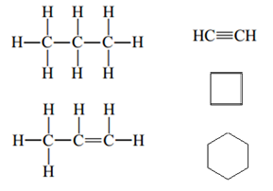
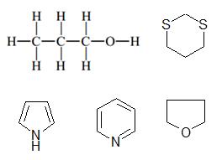
INTRODUCTION
Organic compounds are basically sub-grouped into hydrocarbons and non hydrocarbons.
Hydrocarbons: are those organic molecules that are made up of carbon and hydrogen only as constituent elements. e.g. alkanes, alkenes, alkynes and their cyclic derivatives as well as benzene etc.
Non-hydrocarbons: these are also regarded as hydrocarbon derivatives and are those organic compounds containing one or more element other than carbon and hydrogen (e.g. O, N, S or X like Cl, Br, F, etc.) within their chemical structures e.g. alcohols, amines, thiols and alkyl halides.
Saturated hydrocarbons contain carbon-carbon single bond ((C-C)) entirely while unsaturated ones are characterized by carbon-carbon multiple bond (C=C or C≡C).
Hydrocarbons
Hydrocarbons derivatives

Slide 6
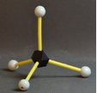
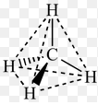

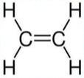

The Bonding Characteristics of Carbon Atom
Carbon is always tetravalent in nature. In organic compounds, carbon can usually achieve this four-bond requirements in three different ways:
Bonding to four other atoms through four single bonds as usually seen in saturated hydrocarbons.
Bonding to three other atoms through two single bonds and one double bond (seen in unsaturated hydrocarbons).
Bonding to two other atoms. This scenario requires the presence of two double bonds or a triple bond and a single bond (seen in unsaturated hydrocarbons).

Slide 7
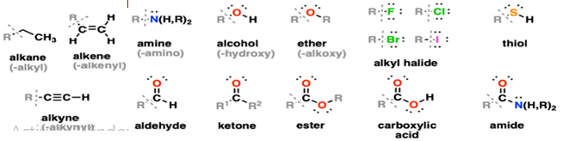
HOMOLOGOUS SERIES
Homologous series. Each particular homologous series represents are family of organic compounds sharing:
Same functional group
Similar chemical properties
Same methods of preparation and
Exhibit gradual change in physical properties
Each of the successive members of every particular homologous series
e.g. alkanes differs by -CH₂- unit. Examples are given below:
Examples of homologous series include: alkenes, alkynes, alcohols, ethers, amines, alkyl halides, nitriles, aldehydes, ketones, carboxylic acids and carboxylic acid derivatives etc.
Table 1.1: Alkane family ; displaying some members of unbranched alkanes
Order Members Chemical formula Difference in
Chemical Units
First Methane CH₄ --
Second Ethane CH₃CH₃ CH₂
Third Propane CH₃CH₂CH₃ CH₂
Fourth Butane CH₃(CH₂)₂CH₃ CH₂
etc.

Slide 8
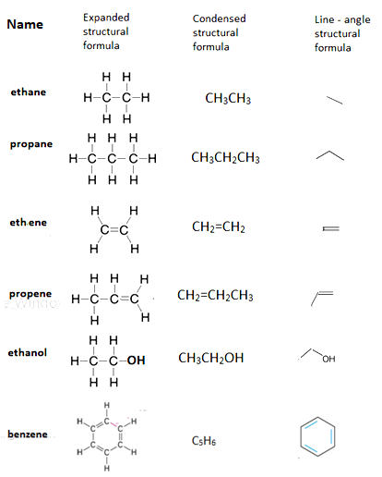
Structural Formula
Condensed Structure: is a structural formula that uses groupings of atoms, in which central atoms and the atoms connected to them are displayed as a group, in order to convey molecular structural information. Bonds are either partially expressed or completely hidden.
Expanded Structure: is a formula that shows all atoms in a molecules and all bonds connecting the atoms together.
Line angle Structure: line angle formula as a more condensed form of structural representation, uses the application of lines and angles to express structural formula. Each line end or an angle represent a carbon atom with all the valences satisfied by hydrogen atoms. Where other atom other than hydrogen (e.g. O, Cl and Br) or group of atoms such as –OH or –NO₂ is attached to carbon, such atoms or groups are clearly indicated.

Slide 9
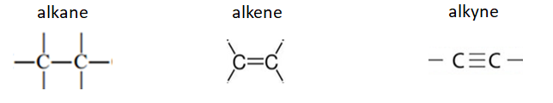
Alkanes, Alkenes and Alkynes
Functional group simply refers to an atom or a specific group of atoms serving as identity of any family of organic compounds. Functional groups are responsible for the chemical properties and many of the physical properties of members constituting that particular family. The functional groups of alkanes, alkenes, and alkynes respectively, are represented below:

Slide 10
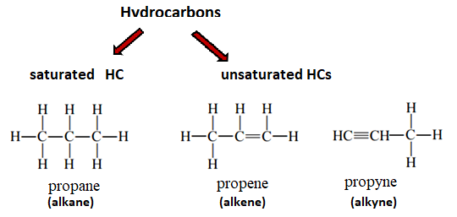
Alkanes, Alkenes and Alkynes
Both alkanes, alkenes and alkynes are hydrocarbons; containing only carbon and hydrogen atoms as part of their constituent elements. Alkanes are saturated hydrocarbons containing carbon and hydrogen atoms linked to each other by single bonds. Alkenes and alkynes are unsaturated hydrocarbons containing at least one carbon-carbon double bond and a carbon-carbon triple bond respectively.

Slide 11
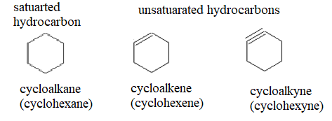

Alicyclic Hydrocarbons
In the alicylic hydrocarbons, the carbon atoms are arranged in rings to yield cyclic structures. These compounds are also generally regarded as alicyclic or cyclic hydrocarbons.
Examples of such families include: cycloalkanes, cycloalkenes and cycloalkynes respectively.
In fact, the hydrocarbons provide a backbone to which various functional groups may be attached to yield an enormous variety of organic compounds.

Slide 12
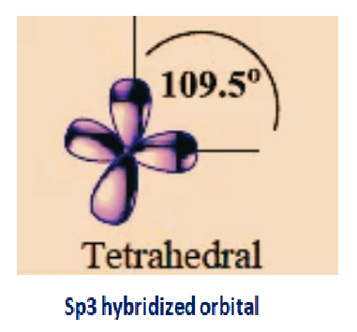
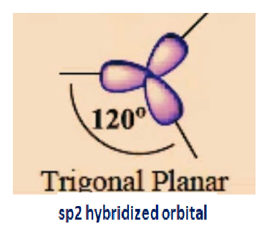
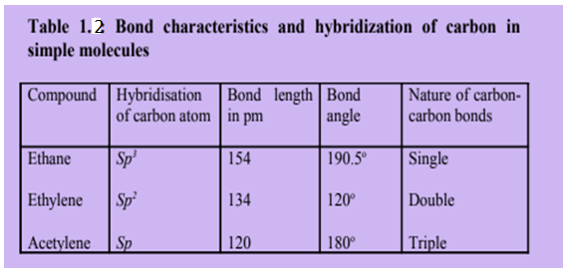
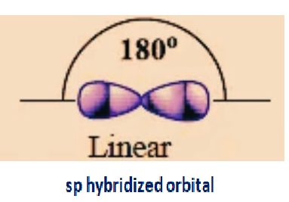
Hybridization of Alkanes, Alkenes and Alkynes
Alkanes→ Sp3 hybridized orbital
Alkenes → sp2 hybridized orbital
Alkynes → sp hybridized orbital

Slide 13
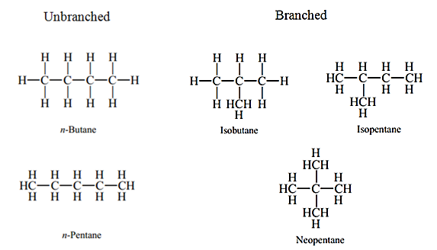
Alkanes
Definition: Alkanes (paraffins) are saturated aliphatic hydrocarbons with general formula, C_{n}H_{2n+2} (where n represents the number of carbon atoms present).
They contain no multiple bond within their chemical structures.
Hence, alkanes are hydrocarbons that contain only carbon-carbon single bond with the rest of the valences being satisfied by hydrogen atoms.

Slide 14
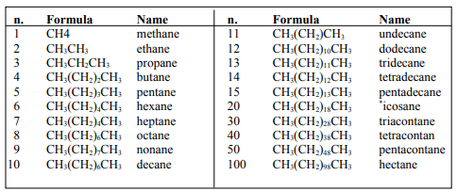
Nomenclature of Alkanes

Slide 15
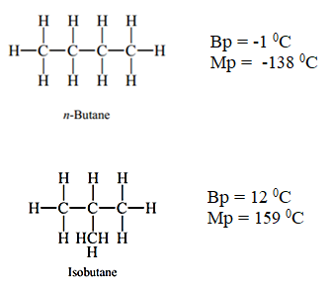
Isomerism
Isomers are defined as compounds with molecular formula but different structural formulae. That is to say, isomers have same numbers and kinds of atoms but differ in the way atoms are arranged (spatial arrangements of atoms) in the respective isomers/molecules. Even though, isomers have the same molecular formula, they are still different compounds with different properties.
Butane has 2 isomers, pentane has 3 isomers, hexane has 5, and heptane has 9 isomers etc.
Molecular formula: C₄H₁₀
Molecular formula: C₄H₁₀
Isomers
Same molecular formula
Different Structural formulae
Different properties and thus
Different compounds
For example, butane and isobutane are different compounds with different properties. They differ in both boiling points (Bp) and melting points (Mp) temperatures.

Slide 16

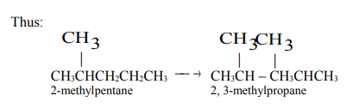
Isomerisation
The molecular rearrangement of one compound into another compound or into more than one compound is called isomerisation. The straight chain alkanes are converted into branched chain isomers in the presence of aluminium chloride and hydrogen chloride.
Similarly, other less branched alkanes isomerise to more branched ones.
Isomerization is used to increase the branched chain content of lower alkanes produced by cracking; you have studied in subsec 2.2.4 that branched chain alkanes are more valuable than straight chain alkanes as motor fuel.

Slide 17
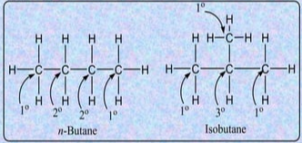
Classes of Carbon and Hydrogen Atoms
Primary carbon (1⁰): Is the carbon atom that is bonded to only one other carbon. All the hydrogen atoms surrounding primary carbon are primary hydrogens.
Secondary carbon (2⁰): Is the carbon atom that is bonded to only two other carbon atoms. All the hydrogen atoms attached to secondary carbon are called secondary hydrogen atoms.
Tertiary carbon (3⁰): Is the carbon atom that is bonded to three other carbons. Each of the hydrogen atoms linked directly to tertiary carbon is also regarded as tertiary hydrogen atom.

Slide 18


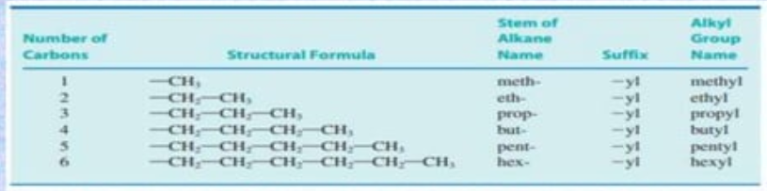

Alkyl Groups and Nomenclature
The alkyl groups, generally represented by R, are derived from alkanes by removing one hydrogen. Alkyl groups (R) are named by replacing the suffix –ane of the parent alkane with -yl.
The simplest alkyl group is methyl group (CH₃-) which is derived alkane, methane (CH₄). Common alkyl groups are listed in Table 1.7, Similarly, aryl groups denoted by Ar, are obtained from benzene and its derivatives by removing one hydrogen. The simplest aryl group is phenyl group (C₆H₅- and is abbreviated as Ph.
Table 1.4: Examples of alkyl groups derived from unbranched alkanes

Slide 19
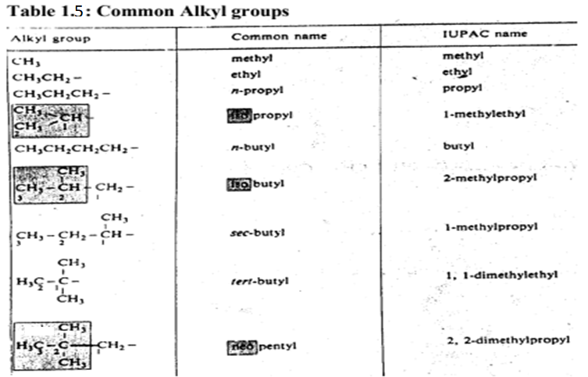

Slide 20
Physical Properties of Alkanes
Phase/state:
At room temperature (25 ⁰C) and 1 atmospheric pressure (1atm):
-C1 to C4 (the first 4 members of the unbranched alkanes) are gases
-C5 to C17 are liquids
-C18 and higher alkanes are wax-like solids
Solubility:
Alkanes are nonpolar molecules with their solubility obeying the critical saying that ‘like dissolves like”.
Alkanes are soluble in nonpolar solvents such as tetrachloromethane CCl₄ and benzene.
Alkenes are insoluble in polar solvents such as water

Slide 21
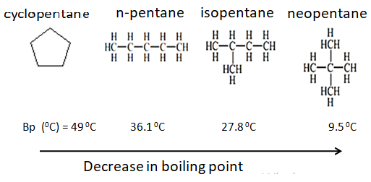
Physical Properties of Alkanes
3. Boiling Point:
Boiling point increases with the increase in the molecular weight (number of carbon atoms) and decreases with branching (among isomeric alkanes).
As the molecular weight becomes higher, the forces of attraction between individual molecules becomes stronger and as a result more energy is required to break such intermolecular forces leading to higher boiling point temperature.
Cycloalkanes have higher boiling points than the corresponding unbranched alkanes.
Table 1.6: Boiling points of unbranched alkanes
Alkane | Structure | Boiling Point (⁰C)
Methane | CH₄ | -161.5
Ethane | CH₃CH₃ | -88.6
Propane | CH₃CH₂CH₃ | -42.1
Butane | CH₃(CH₂)₂CH₃ | -0.5
Pentane | CH₃(CH₂)₃CH₃ | 36.1

Slide 22
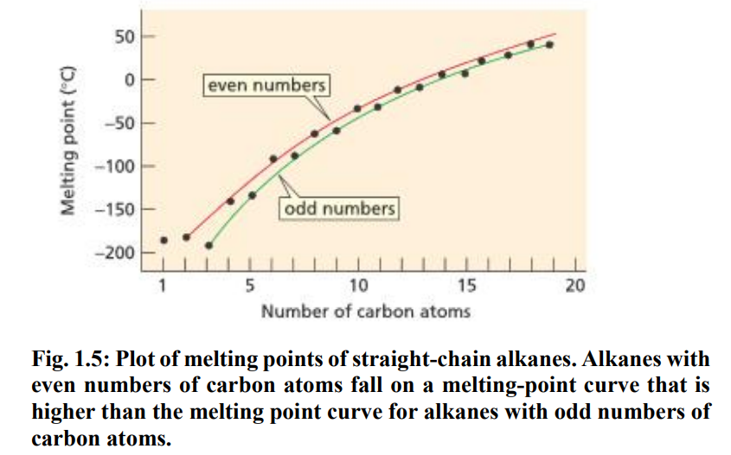
Physical Properties of Alkanes
4. Melting Point
Unsmooth/irregular increase in boiling point
Molecules with an odd number of carbon atoms have lower melting point than those with an even number of carbon atoms.
It happens because alkanes with even number of carbon atoms have their atoms in their molecules well organized/compacted than what is seen in those with odd number of carbon atoms.
This is reflected in the lower melting points of alkanes with odd number of carbon atoms.
Separate curves for the alkanes with even number of carbons and odd those with number of carbons, indicate smooth increase in melting point each.
Example of alkanes with Even number of carbons include: ethane butane, hexane etc.
Example of alkanes with odd number of carbons are propane, pentane, heptane etc.

Slide 23
Physical Properties of Alkanes
There is alternation as one progresses from an unbranched alkane with an even number of carbon atoms to the next one with odd number of carbon atoms. For example, propane (mp= -188 ⁰C) melts lower than ethane (mp= -172 ⁰C) and even lower than methane (mp= -183 ⁰C). Butane (mp= -138 ⁰C) melts at 53 ⁰C higher than propane (mp= -188 ⁰C) and 5 ⁰C lower than pentane (mp= -130 ⁰C).
Table 1.7: Melting points of unbranched alkanes
Alkane+ | Structure | Melting Point (⁰C)
Methane | CH₄ | -183
Ethane | CH₃CH₃ | -172
Propane | CH₃CH₂CH₃ | -188
Butane | CH₃(CH₂)₂CH₃ | -138
Pentane | CH₃(CH₂)₃CH₃ | -130
5. Density:
The maximum density of alkane is about 0.8, thus, all alkanes are lighter than water.

Slide 24
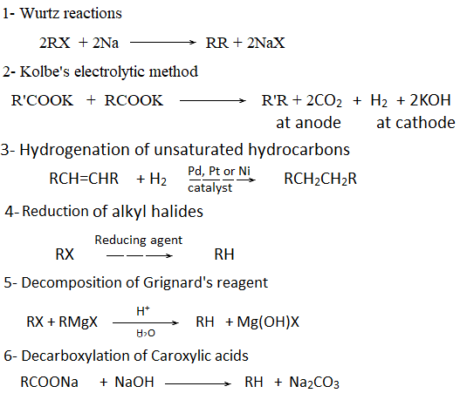
Preparation of Alkanes
Alkanes are generally obtained from natural sources: petroleum and natural gas. However, synthetic methods are more practical when a pure alkane is required. Alkanes can be prepared from: (a) alkenes or a alkynes, (b) alkyl halides, and (c) carboxylic acids.

Slide 25
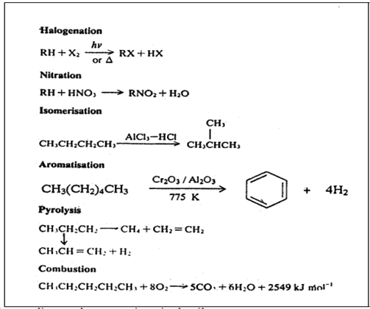



Reactions of Alkanes
Alkanes are also known as paraffins. The name paraffin comes from two Latins words, “Paraum and affinis”, which mean “little affinity”. This name was suggested because these hydrocarbons were apparently unreactive. However, under certain conditions, alkanes can undergo the following reactions:
Sulfonation reaction
Combustion/Oxidation leads to different products with KMnO₄ as oxidizing agent we get alcohol.
The general formula for combustion or oxidation reaction to produce CO₂ and water is given below:

Slide 26
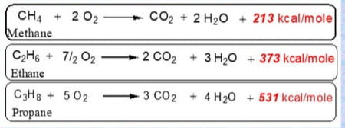

Reactions of Alkanes
Combustion
When ignited in the presence of excess oxygen/air, alkanes are oxidized into carbon dioxide and water and heat is liberated (160 kcal of heat is liberated for each methyl group).
Incomplete combustion of alkenes yields poisonous carbon monoxide (CO) or carbon. Both of which contribute to air pollution.

Slide 27
Alkenes
Alkenes, also called olefins, are acyclic unsaturated hydrocarbons which contain one or more carbon-carbon double bond(s). Alkene family has the general formula C_{n}H_{2n}. Thus the simplest member of alkene family is ethene with the molecular formula C₂H₄ and structural formula of CH₂=CH₂. The next member contains three carbon atoms and has molecular formula C₃H₆. While the structural formula is CH₂=CH-CH₃. Cycloalkenes are cyclic derivatives of alkenes and are called alicyclic alkenes.
Alkenes are often obtained as plant products or as in petroleum products. Many alkenes are biologically active compounds. For example, ethene induces ripening in fruit.

Slide 28
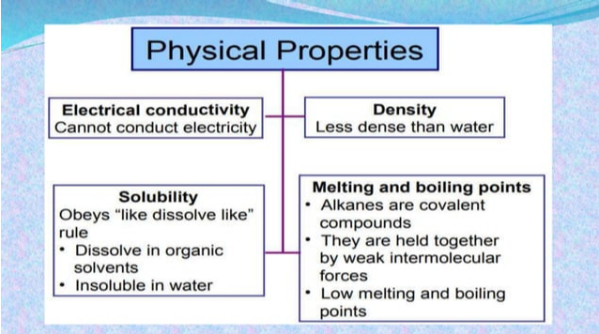
Physical Properties
Physical Properties In general, the physical properties of alkenes are similar to those of the corresponding alkanes.
Like alkanes, the boiling points of a homologous series of alkenes increase 20-30K per additional CH₂ group except for the very few homologues.
Like alkanes, branching in an alkene also lowers the boiling point.
Lower alkenes, from ethane to butane, are colourless gases, higher ones, from C5 - C15, are liquids and the rest are solids at room temperature.
Alkenes are completely soluble in nonpolar solvents but slightly more soluble in water than the corresponding alkanes because the π - electrons are attracted to the partially positive hydrogen of the water molecules.
Fig. 1.6: Physical properties of alkenes

Slide 29
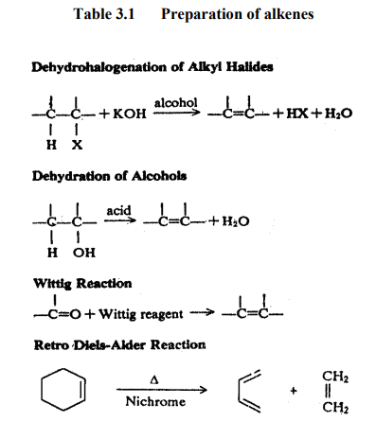
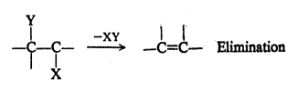
Preparation of Alkenes
Synthetically, alkenes are prepared by introducing a double bond in saturated hydrocarbons through elimination of atoms or groups from two adjacent carbon atoms. The result is the formation of a double bond between these two carbon atoms.
Alkenes can be prepared from alkyl halides, alcohol and ketones and through cleavage reactions. X

Slide 30
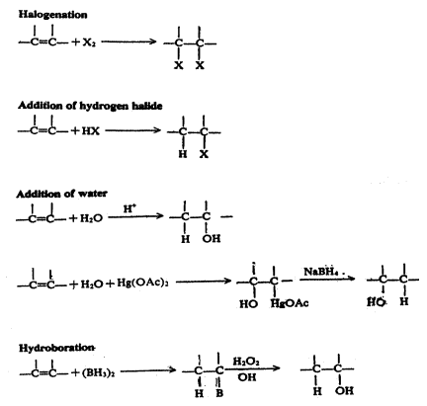
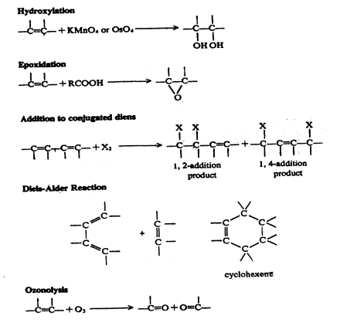
Reactions of Alkenes

Slide 31

Alkynes
Alkynes are hydrocarbons which contain carbon-carbon triple bond with general formula C_{n}H_{2n-2}.
Ethyne, CH ≡ CH, the simplest alkyne, was burnt in the miners’ lamps before electric lamps were developed. It is used in oxyacetylene torches for cutting and welding metals. It is extensively used as a fuel gas. In industry, it is the starting material for the preparation of many important chemicals, e.g., ethanoic acid, chloroethene (vinyl chloride), propanone, butanol, ethanol, etc.
A large number of naturally occurring compounds containing triple bonds have been isolated from plant kingdom. For example, a triyne from safflower has considerable activity against nematodes and evidently forms part of the plant’s chemical defiance against infestation.

Slide 32
Physical Properties
The physical properties of alkynes are similar to those of corresponding alkenes.
They are all colourless and odourless (except ethyne)
The first three members (C2 to C4), i.e., ethyne, propyne and 1-butyne, are gases at room temperature; the next eight members (C5 to C C12) are liquids and the higher members (C13 or greater) are solids.
The physical constants like melting points, boiling points and densities increase gradually with the increase in molecular weight.
Alkynes have slightly higher boiling points than the corresponding alkenes and alkanes.
Terminal alkynes have lower boiling points than the isomeric internal alkynes and can be separated by careful fractional distillation.
Alkynes share with alkanes and alkenes the properties of low density and low water solubility. They are nonpolar and dissolve readily in typical organic solvents, such as diethyl ether, chlorinated hydrocarbons, etc
Note: The increase in boiling point with increase in molecular weight is due to increased London forces.

Slide 33
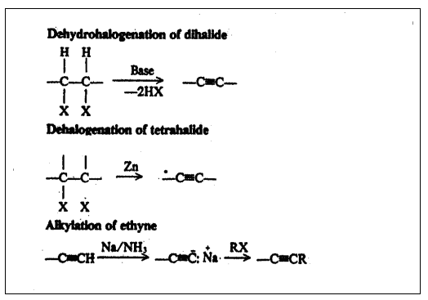
Preparation
Organic synthesis makes use of two major reaction types: one is functional group transformation and the other is carbon-carbon bond forming reaction. Both these strategies are applied to the preparation of alkynes. In this unit, we shall discuss how alkynes are prepared by elimination reactions and by adding alkyl group(s) to the smaller ethyne unit.

Slide 34
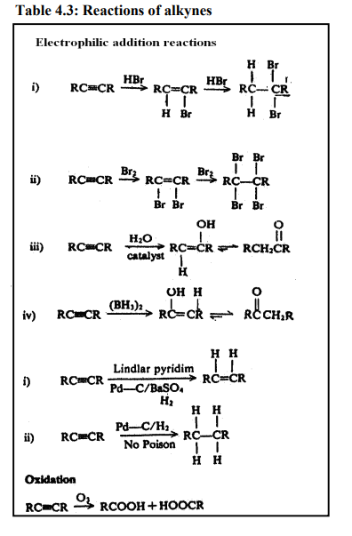
Reactions of Alkynes
Due to the presence of loosely held π electrons, alkynes undergo reactions similar to those of alkenes. Characteristic reactions of alkynes include electrophilic additions, reduction and oxidation

Slide 35
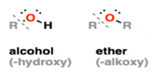
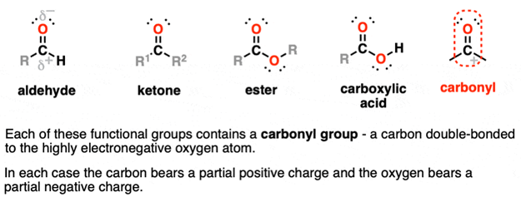
Hydrocarbon Derivatives
Alcohols, ethers, amines, alkyl halides, nitriles, aldehydes, ketones, carboxylic acids and derivatives are examples of hydrocarbon derivatives. Let us now study about the structural features of some classes of aliphatic compounds. The compounds in which the carbon and oxygen atoms are linked by a single bond can be classified as alcohols or ethers, depending upon the number of alkyl groups attached to oxygen. In alcohols, oxygen is linked to only one alkyl group and one hydrogen; but in ethers, oxygen has two alkyl groups attached to it.
The compounds containing carbon and oxygen linked by a double bond (i.e C = O, which is called carbonyl group, can be classified as aldehydes or ketones, depending on whether the number of alkyl groups attached to carbonyl carbon is one or two, respectively. If instead of an alkyl group, one hydroxyl (-OH) group is attached to the carbonyl group, a class of compounds known as carboxylic acids.

Slide 36
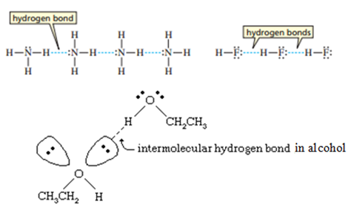
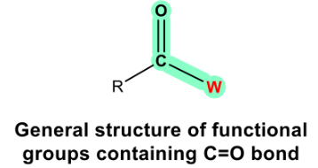
Hydrocarbon Derivatives
Alcohols, Ethers, Amines, Nitriles, Alkyl Halides
These functional groups are considerably more polar due to the greater difference in electronegativities between the bonding atoms. Stronger intermolecular forces are present in these functional groups due to the dipole-dipole interactions. Additionally, alcohols and amines are capable of forming hydrogen bonding, which further increases boiling points. Alcohols R-OH contain carbon bonded to the hydroxyl group -OH.
Aldehydes, Ketones, Carboxylic Acids, and Carboxylic Acid derivatives
The C=O group is referred to as the carbonyl group. The C=O bond is strongly polarized towards oxygen and the carbon bears a partial positive charge. Carbonyls are found in aldehydes, ketones, esters, and carboxylic acids.
Fig. 1.7: Hydrogen bonding in (a) ammonia (b) ethanol

Slide 37
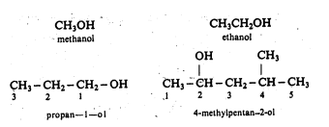

Alcohols
Physical Properties of Alcohols
Lower members are liquids at room temperature.
Higher members (from C12) are waxy solids.
Short chain alcohols are water soluble due to improved polarity.
The longer the hydrophobic alkane chain in alcohols, the lower the solubility in water.
Alcohols: Alcohols are the compounds having hydroxyl (-OH) group attached to the alkyl chain. and these compounds are much weaker organic acids, with p^{K}a values close to 16 (which is a high value). Methanol and ethanol are examples of alcohols.
Alcohols: Alcohols are the compounds having hydroxyl (-OH) group attached to the alkyl chain.
The common names of the alcohols are written by specifying the alkyl group followed by the word alcohol e.g. methyl alcohol, CH₄OH.

Slide 38

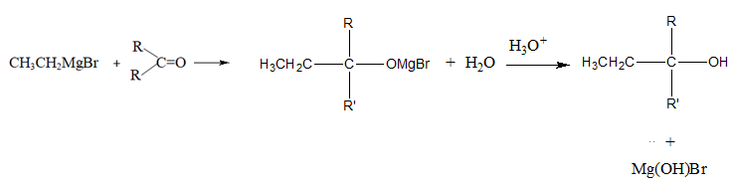
Preparation of Alcohols
There exist various methods for the preparation of alcohols. The followings are some of the most common or general methods of preparation of alcohols:
1. Hydration of Alkenes
Direct hydration takes place by net addition of water. It might occur under acid catalyzed condition.
2. Grignard Synthesis
All three types of alcohol (primary, secondary and tertiary) can be prepared from the Grignard reagents by interaction with suitable carbonyl compounds. The reaction of the Grignard reagent with formaldehyde leads to primary alcohols, while that with aldehydes other than formaldehyde yields secondary alcohols and that with ketones gives tertiary alcohols.

Slide 39
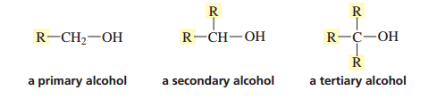
Classification of Alcohols
Alcohols are classified into three groups: primary, secondary, and tertiary, depending upon where the OH group is attached to the molecule.
If the OH group occurred on a terminal (primary) carbon atom, it is a primary alcohol and the carbon is termed as a primary carbon.
If the OH group is attached to a carbon atom that is joined to two other carbon atoms, it is a secondary alcohol, and the carbon atom to which it is attached is a secondary carbon atom.
If the OH group is attached to a carbon atom that is joined to three other carbon atoms, it is a tertiary alcohol, and the carbon atom to which it is attached is a tertiary carbon atom.

Slide 40

Ethers
Ethers (R-O-R’) cannot serve as hydrogen-bond donors, so their boiling points are lower than those of alcohols of equivalent molecular weight, but higher than those of hydrocarbons due to greater dipole-dipole forces.
The common names for ethers are derived by naming the two alkyl groups in alphabetical order followed by the word ether. This is illustrated in the examples given below: CH₃OCH₃ (dimethyl ether) CH₃OCH₂CH₃ (ethyl methyl ether). In the IUPAC system, ethers are named as alkoxyalkanes. The larger of the two alkyl groups is chosen as the hydrocarbon chain. For example, the compound, CH₃OCH₂CH₃ is named as 1-methoxyethane and not as ethoxymethane. Similarly, the compound

Slide 41
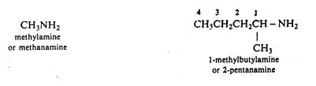
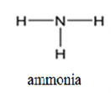
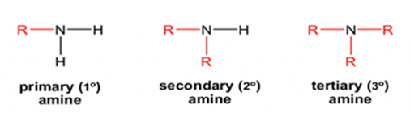
Amine and its Classification
Amines contain the functional group -NH₂, -NHR, or NR₂ where R is a hydrocarbon Amine substituents are known as amino groups.
Amines with N-H bonds are capable of hydrogen bonding, which leads to higher boiling points and water solubility.
The lone pair on the nitrogen can act as a base.
Amine is the organic derivative of ammonia, NH₃.
When the hydrogen atom(s) in NH₃ is replaced with R groups, it produces amine. Amine can be primary (1°), secondary (2°) or tertiary (3°) depending on how many R groups are connected with nitrogen. Amines can also be associated with certain common names.

Slide 42

Aldehydes
RCHO) have Carbon atom of the C=O directly bonded to carbon and to H atom. Formaldehyde, acetaldehyde, and benzaldehyde are common examples. They have polar covalent bonding but are not hydrogen bond donors.
Lower members of this class are commonly named after the acids that they form on oxidation. For example, HCHO, formaldehyde is named so because it forms formic acid (HCOOH) on oxidation. In the IUPAC system of nomenclature, they are named as alkanals e.g. ethanal for CH₃CHO.

Slide 43

Ketones
Ketones (RC(O)R’) have carbon of the C=O bonded to two other carbons. Acetone or Dimethyl ketone (or 2-propanone) is a nail polish remover. The common names for ketones are written similar to ethers, i.e. the two alkyl groups are written alphabetically followed by the word ketone. For example, the compound,

Slide 44


Carboxylic acids
Carboxylic Acids (RCOOH) have a carbonyl carbon bonded to –OH and to an alkyl group from the other side. Acetic acid (vinegar) and formic acid are the simplest carboxylic acids. Other short-chain acids like butanoic and pentanoic acids are notorious for their locker-room smells (or worse).
The hydroxyl group participates in hydrogen bonding; as a result, carboxylic acids have higher boiling points. Despite the name, carboxylic acids tend to be relatively weak acids and can only partially dissociate in water (as compared to strong acids such as HCl and H₂SO₄).
Nowhere else in organic chemistry, the common names are so prevalent as they are among carboxylic acids. Some examples are listed in Table 1.8.

Slide 45




Carboxylic Acid Derivatives
There are actually quite a few important functional groups containing carbonyls. These functional groups are all considered to be derived from carboxylic acids, as they can be obtained through replacement of OH with various groups.
Carboxylic acid derivatives include: ester, Amides, Acid Halides, Anhydrides, Nitriles.
In ester the O-H bond of carboxylic acid is replaced with an O-R group.
In amides the O-H bond of carboxylic acid is replaced with an –NH₂, -NHR, or -NR₂ group.
In acid halides the O-H bond of carboxylic acid is replaced with an X group (F, Cl, Br, I).
Anhydrides contain an oxygen flanked between two carbonyls. Distinct from esters.
Nitriles might not appear to be related to carboxylic acids at first glance, but they can actually be converted into amides through hydration.

Slide 46
Thank You

